Slide 1
Feature Detection & Representation
Last updated: 18-3-2024
[GR1] Gonzalez R. C., Woods R. E., Eddins S. L., Digital Image Processing Using Matlab, Pearson Education, 2nd edition, 2009. (Ch. 11)
[GR2] Gonzalez R. C., Woods R. E., Eddins S. L., Digital Image Processing, Pearson Education, 3rd edition, 2007. (Ch. 11)
Dr. Zulfiqar Habib, Professor
http://vig.cuilahore.edu.pk

Slide 2
Feature Detection & Representation
Model Generation
Models
Image acquisition
Preprocessing
Segmentation
Feature extraction
Classification / Regression
Problem domain
Knowledge base
Result

Slide 3
Image Representation
Objective: To represent and describe information embedded in an image in other forms that are more suitable than the image itself.
Benefits: - Easier to understand
- Require fewer memory, faster to be processed
- More “ready to be used”
What kind of information we can use?
External Characteristics: Boundary, shape, perimeter, perimeter length
Internal Characteristics: Color, Texture, Region, Relation between regions
Features selected should be as insensitive as possible as variations in size, translation, and rotation.
Notes:
Image regions (including segments) can be represented by either the border or the pixels of the region. These can be viewed as external or internal characteristics, respectively.

Slide 4
Regional Descriptors
Purpose: to describe regions or “areas”
1. Some simple regional descriptors (discussed above)
- area of the region
- length of the boundary (perimeter) of the region
- Compactness
2. Topological Descriptors, e.g. Eular number
3. Texture descriptors

Slide 5
Image Representation
Boundary Following
The boundary is a good representation of an object shape and also requires less memory.
We assume that:
We are working with binary images in which the object and the background points are labeled 1 and 0, respectively.
The images are padded with a border of 0s to eliminate the possibility of an object merging with the image border.
Once a binary image has been processed, we can obtain properties about the regions in the processed image. Some of those properties are:
Area, centroid, perimeter, perimeter length, circularity of the region and second circularity measure

Slide 6

Image Representation
Boundary Following
# Define the binary image
f = np.array([
[1, 1, 1, 0, 0, 0, 0, 0],
[1, 1, 1, 0, 1, 1, 0, 0],
[1, 1, 1, 0, 1, 1, 0, 0],
[1, 1, 1, 0, 0, 0, 1, 0],
[1, 1, 1, 0, 0, 0, 1, 0],
[1, 1, 1, 0, 0, 0, 1, 0],
[1, 1, 1, 0, 0, 1, 0, 0],
[1, 1, 1, 0, 0, 0, 0, 0]
], dtype=np.uint8)
# Find contours. Note: RETR_EXTERNAL retrieves only the extreme outer contours
contours, _ = cv2.findContours(f, cv2.RETR_EXTERNAL, cv2.CHAIN_APPROX_NONE)
# Extract the first contour
first_contour = contours[0]
# Note: OpenCV returns (x, y) coordinates, not (row, col), so we might need to swap them
first_contour_swapped =
np.array([(y, x) for [[x, y]] in first_contour])
# Print the coordinates starting from
# top-left and moving clockwise
print(first_contour_swapped)
1 | 1 | 1 | 0 | 0 | 0 | 0 | 0
1 | 1 | 1 | 0 | 1 | 1 | 0 | 0
1 | 1 | 1 | 0 | 1 | 1 | 0 | 0
1 | 1 | 1 | 0 | 0 | 0 | 1 | 0
1 | 1 | 1 | 0 | 0 | 0 | 1 | 0
1 | 1 | 1 | 0 | 0 | 0 | 1 | 0
1 | 1 | 1 | 0 | 0 | 1 | 0 | 0
1 | 1 | 1 | 0 | 0 | 0 | 0 | 0
1 | 1 | 1 | 0 | 0 | 0 | 0 | 0
1 | 1 | 1 | 0 | 1 | 1 | 0 | 0
1 | 1 | 1 | 0 | 1 | 1 | 0 | 0
1 | 1 | 1 | 0 | 0 | 0 | 1 | 0
1 | 1 | 1 | 0 | 0 | 0 | 1 | 0
1 | 1 | 1 | 0 | 0 | 0 | 1 | 0
1 | 1 | 1 | 0 | 0 | 1 | 0 | 0
1 | 1 | 1 | 0 | 0 | 0 | 0 | 0
1 | 1 | 1 | 0 | 0 | 0 | 0 | 0
1 | 1 | 1 | 0 | 1 | 1 | 0 | 0
1 | 1 | 1 | 0 | 1 | 1 | 0 | 0
1 | 1 | 1 | 0 | 0 | 0 | 1 | 0
1 | 1 | 1 | 0 | 0 | 0 | 1 | 0
1 | 1 | 1 | 0 | 0 | 0 | 1 | 0
1 | 1 | 1 | 0 | 0 | 1 | 0 | 0
1 | 1 | 1 | 0 | 0 | 0 | 0 | 0

Slide 7
Image Representation
Boundary Following
# Read the image
Coins = cv2.imread('coins.jpg')
Coins_gray = cv2.cvtColor(Coins, cv2.COLOR_BGR2GRAY)
_, CoinsBW = cv2.threshold(Coins_gray, 127, 255, cv2.THRESH_BINARY)
# Find contours in the binary image
contours, _ = cv2.findContours(CoinsBW, cv2.RETR_EXTERNAL, cv2.CHAIN_APPROX_SIMPLE)
CoinBoundary = contours[0]
# Display the original image
plt.imshow(cv2.cvtColor(Coins, cv2.COLOR_BGR2RGB))
# Plot the boundary.
plt.plot(CoinBoundary[:, 0, 0], CoinBoundary[:, 0, 1], 'r',
linewidth=2)
plt.show()

Slide 8
Image Representation
Region Properties: Area and Centroid
Area A = Sum of all the 1-pixels in the region of interest, say label 2
= 8
Centroid is the average location of the pixels in the region
Centroid = (horizontal center, vertical center)
= (r’, c’)
r’ = (Sum of all the rows positions in the region) / A
= (2+3+2+3+7+4+5+6) / 8
= 4
c’ = (Sum of all the columns positions in the region) / A
= (5+5+6+6+6+7+7+7) / 8
= 6.125 ≅ 6
1 | 1 | 1 | 0 | 0 | 0 | 0 | 0
1 | 1 | 1 | 0 | 2 | 2 | 0 | 0
1 | 1 | 1 | 0 | 2 | 2 | 0 | 0
1 | 1 | 1 | 0 | 0 | 0 | 2 | 0
1 | 1 | 1 | 0 | 0 | 0 | 2 | 0
1 | 1 | 1 | 0 | 0 | 0 | 2 | 0
1 | 1 | 1 | 0 | 0 | 2 | 0 | 0
1 | 1 | 1 | 0 | 0 | 0 | 0 | 0
Notes:
Ref. Morphology: Labeling Connected Components
Count row (col) numbers while taking sum.

Slide 9
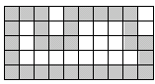
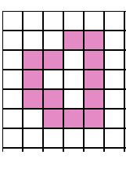
Image Representation
Region Properties: Perimeter
A simple definiton of the perimeter of a region without holes is the set of its interior border pixels.
A pixel of a region is a border pixel if it has some neighboring pixel that is outside the region.
When 8-connectivity is used to determine whether a pixel inside the region is connected to a pixel outside the region, the resulting set of perimeter pixel is 4-connected.
When 4-connectivity is used to determine whether a pixel inside the region is connected to a pixel outside the region, the resulting set of perimeter pixel is 8-connected.

Slide 10
Image Representation
Region Properties: The length of a perimeter
To compute length |P| of perimeter P, the pixels in P must be ordered in a sequence:
P = <(r₀,c₀),. . . , (r_{k-1},c_{k-1})>,
each pair of successive pixels in the sequence being neighbor, including the first and last pixels.

Slide 11
Image Representation
Region Properties: Circularity
Circularity of an object is usually determined by
Circularity = (4*Area*pi)/(Perimeter.^2)
If the circularity is greater than 0.9 then the object may be considered circular in shape.

Slide 12
Image Representation
Region Properties: Example
f = [1 1 1 0 1 1 1 1 1 0; 1 1 1 0 1 1 1 1 1 0; 1 1 1 1 1 1 1 1 1 1; 1 1 1 1 1 1 1 1 1 1; 1 1 1 1 1 1 1 1 1 1]
f =
1 1 1 0 1 1 1 1 1 0
1 1 1 0 1 1 1 1 1 0
1 1 1 1 1 1 1 1 1 1
1 1 1 1 1 1 1 1 1 1
1 1 1 1 1 1 1 1 1 1
g = im2bw(f);
regionprops(g, 'area')
ans =
Area: 46
regionprops(g, 'centroid')
ans =
Centroid: [3.1304 5.3696]
gp8 = bwperim(g, 8)
gp8 =
1 1 1 0 1 1 1 1 1 0
1 0 1 0 1 0 0 0 1 0
1 0 1 1 1 0 0 0 1 1
1 0 0 0 0 0 0 0 0 1
1 1 1 1 1 1 1 1 1 1
gp4 = bwperim(g, 4)
gp4 =
1 1 1 0 1 1 1 1 1 0
1 0 1 0 1 0 0 0 1 0
1 0 0 1 0 0 0 0 0 1
1 0 0 0 0 0 0 0 0 1
1 1 1 1 1 1 1 1 1 1
r’ = 144/46
c’ = 247/46
regionprops(g, 'perimeter')
ans =
Perimeter: 28.2426

Slide 13
Image Representation
Region Properties: Example
f = [1 1 1 0 0 0 0 0; 1 1 1 0 1 1 0 0; 1 1 1 0 1 1 0 0; 1 1 1 0 0 0 1 0; 1 1 1 0 0 0 1 0; 1 1 1 0 0 0 1 0; 1 1 1 0 0 1 0 0; 1 1 1 0 0 0 0 0];
fL = bwlabel(f);
fProp = regionprops(fL, ‘all');
C1 = round(fProp(1).Centroid)
C1 =
2 5
A1 = round(fProp(1).Area)
A1 =
24
P1 = round(fProp(1).Perimeter)
P1 =
17
Circularity1 = (4*A1*pi)/P1.^2
Circularity1 =
1.0436
C2 = round(fProp(2).Centroid)
C2 =
6 4
A2 = round(fProp(2).Area)
A2 =
8
P2 = round(fProp(2).Perimeter)
P2 =
13
Circularity2 = (4*A2*pi)/P2.^2
Circularity2 =
0.5949
(col, row)
1 | 1 | 1 | 0 | 0 | 0 | 0 | 0
1 | 1 | 1 | 0 | 2 | 2 | 0 | 0
1 | 1 | 1 | 0 | 2 | 2 | 0 | 0
1 | 1 | 1 | 0 | 0 | 0 | 2 | 0
1 | 1 | 1 | 0 | 0 | 0 | 2 | 0
1 | 1 | 1 | 0 | 0 | 0 | 2 | 0
1 | 1 | 1 | 0 | 0 | 2 | 0 | 0
1 | 1 | 1 | 0 | 0 | 0 | 0 | 0
Rough estimate

Slide 14
Image Representation
Region Properties: Example
I = imread('coins.png');
Ibw = im2bw(I);
Ibw = imfill(Ibw, 'holes');
Ilabel = bwlabel(Ibw);
stat = regionprops(Ilabel, 'centroid');
imshow(I);
hold on;
for x = 1: numel(stat)
plot(stat(x).Centroid(1), stat(x).Centroid(2), 'ro');
end
Notes:
Ref. Morphology: Labeling Connected Components: Boundary Extraction (can also be done through erosion)

Slide 15
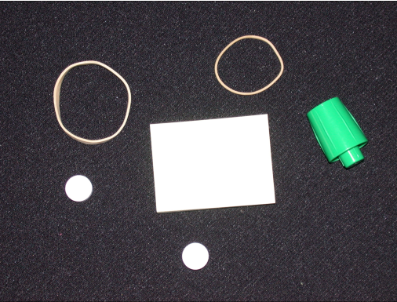
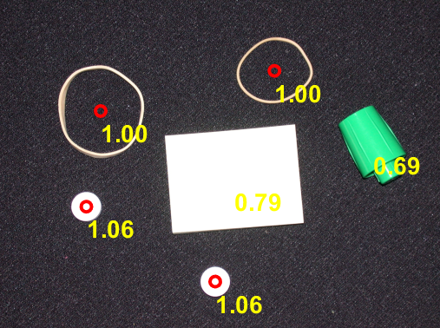
Image Representation
Example - Identifying Round Objects
clc; clear; clearvars; close all hidden
I = imread('pillsetc.png');
Ibw = im2bw(I);
Ibw = bwareaopen(Ibw,30);
se = strel('disk',2);
Ibw = imclose(Ibw,se);
Ibw = imfill(Ibw, 'holes');
Ilabel = bwlabel(Ibw);
stat = regionprops(Ilabel, 'all');
n = 0;
imshow(I);
hold on;
for x = 1:numel(stat)
area = stat(x).Area;
perimeter = stat(x).Perimeter;
circularity = (4*area*pi)/perimeter.^2;
if circularity > 0.9
plot(stat(x).Centroid(1), stat(x).Centroid(2), 'ro','LineWidth',2);
n = n + 1;
end
metric_string = sprintf('%2.2f', circularity);
text(stat(x).Centroid(1),stat(x).Centroid(2)+25,metric_string,'Color','y','FontSize',14,'FontWeight','bold');
end
disp("Total number of round objects = "+string(n));
Total number of round objects = 4
Notes:
LargestRoundObject.mlx

Slide 16
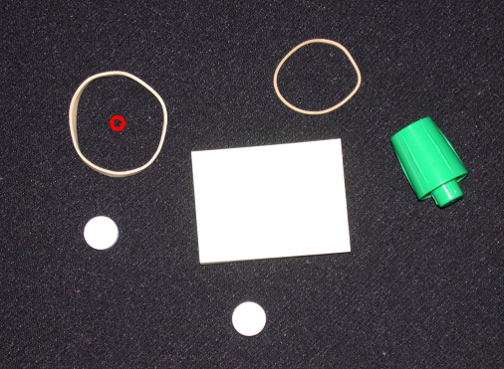
Image Representation
Exercise - Identifying Largest Round Object
Notes:
RoundObjectDetection.mlx

Slide 17
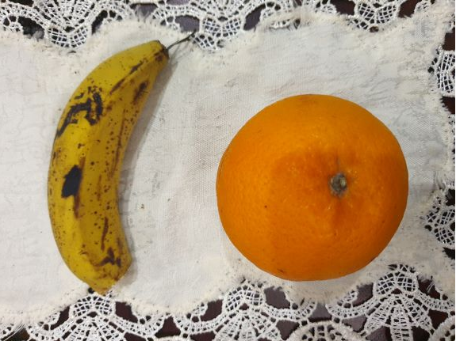
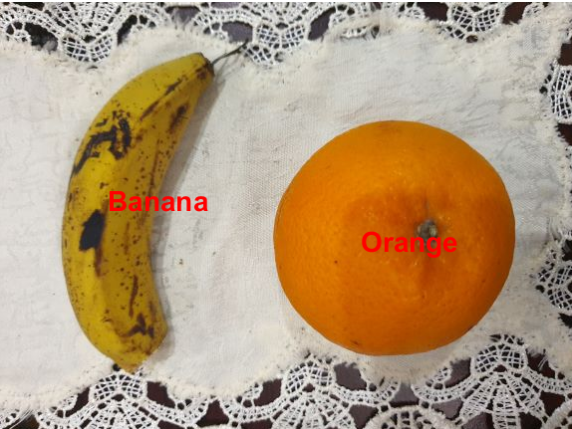
Image Representation
Exercise – Identification & Labelling
Create a picture of at least two different fruits or vegetables available at your home. Use this picture and names of items in this picture as the input of code which can do the following:
Identify the items in picture and label accordingly.
Test your code on more than two types of fruits/vegetables for the bonus marks.
Notes:
Fruits_identification.mlx

Slide 18
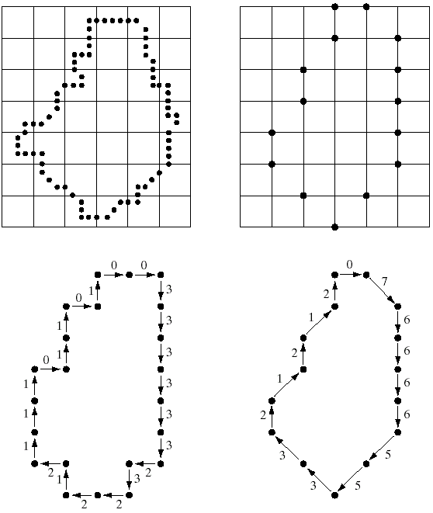
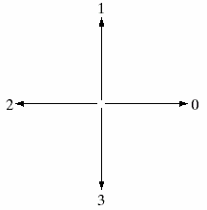
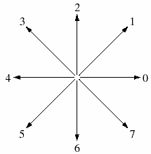
Boundary Descriptors
Chain Codes & Shape Numbers
Object
boundary
(resampling)
Boundary
vertices
4-directional
chain code
8-directional
chain code
Chain code: 0033333323221211101101 076666553321212

Slide 19
Boundary Descriptors
Chain Codes & Shape Numbers: Analysis
The chain code of the boundary depends on the starting point.
It is also dependent on shape/boundary orientation (rotation angle).
Chain code can be made insensitive
to the starting point by using circular sequence and choosing the integer of minimum magnitude as the starting point.
to rotations that are multiples of 90º by using the Circular First Difference (CFD) of the code, called shape number.
The shape number of a boundary, generally based on 4-directional Freeman chain codes, is defined as the first difference of smallest magnitude.
The order n of a shape number is defined as the number of digits in its representation.
Size normalization can be achieved by adjusting the size of the resampling grid.

Slide 20
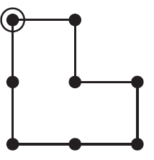
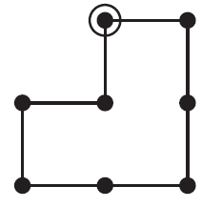
Boundary Descriptors
Chain Codes & Shape Numbers: Example
Chain code: 0 3 0 3 2 2 1 1
Circular list: 0 3 0 3 2 2 1 1 0
c_{i+1}-c_{i}: 3 -3 3 -1 0 -1 0 -1
CFD → ((c_{i+1}-c_{i} )+4) mod 4: 3 1 3 3 0 3 0 3
Min magnitude: 0 3 0 3 3 1 3 3 (normalized)
Chain code: 0 3 3 2 2 1 0 1
Circular list: 0 3 3 2 2 1 0 1 0
c_{i+1}-c_{i}: 3 0 -1 0 -1 -1 1 -1
CFD : 3 0 3 0 3 3 1 3
Min magnitude: 0 3 0 3 3 1 3 3 (normalized)
Therefore, the shape number of both images is 03033133 of order 8.
Ch12-p.368
Notes:
sparc.nfu.edu.tw/~reed/WWW/image100/Chap12.ppt

Slide 21
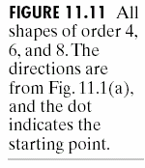
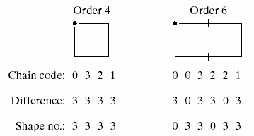
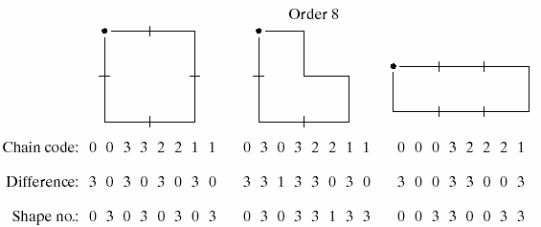
Boundary Descriptors
Chain Codes & Shape Numbers: TODO
Notes:
sparc.nfu.edu.tw/~reed/WWW/image100/Chap12.ppt

Slide 22
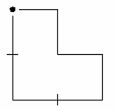
Boundary Descriptors
Chain Codes & Shape Numbers: TODO
Check if the shape number for the above shape is invariant to:
Starting position
Rotation (90 degree intervals)
Notes:
sparc.nfu.edu.tw/~reed/WWW/image100/Chap12.ppt

Slide 23
Regional Descriptors
Purpose: to describe regions or “areas”
1. Some simple regional descriptors (discussed above)
- area of the region
- length of the boundary (perimeter) of the region
- Compactness
2. Topological Descriptors, e.g. Eular number
3. Texture descriptors

Slide 24
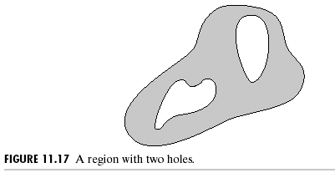
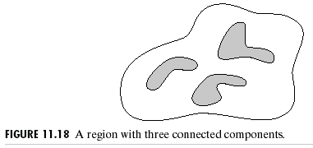
Regional Descriptors
Topological
Properties of shapes that are invariant to rotation, translation, scaling, and other
geometric transformations. Used to describe holes and connected components of the region
Euler number (E):
C = the number of connected
components
H = the number of holes

Slide 25
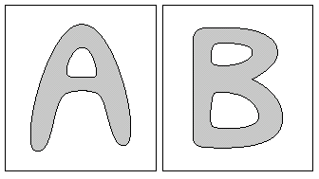
Regional Descriptors
Topological
E = 1-2 = -1
E = 1-1 = 0
Euler Formula

Slide 26
Python Code for Computing the Eular number of a region:
# Find the area of each connected component, then find the largest one (excluding the background which is labeled 0)
props = measure.regionprops(label_image)
largest_region = max(props, key=lambda x: x.area if x.label != 0 else 0)
# Create a mask for the largest region
largest_region_mask = label_image == largest_region.label
# Compute the Euler number of the largest region
euler_number = measure.euler_number(largest_region_mask)
print(f"Euler Number of the Largest Region: {euler_number}")
import numpy as np
from skimage import io, color, measure, morphology
from skimage.filters import threshold_otsu
# Load the image
image_path = 'bottles.tif'
image = io.imread(image_path)
# Assume grayscale image is loaded
gray_image = image
# Convert the grayscale image to binary
thresh = threshold_otsu(gray_image)
binary_image = gray_image > thresh
# Label connected components
label_image = measure.label(binary_image)

Slide 27
Regional Descriptors
Texture
Texture is usually defined as the smoothness or roughness of a surface.
It is the visual appearance of the uniformity or lack of uniformity of brightness and color.
There are two types of texture: random and regular.
Random texture cannot be exactly described by words or equations; it must be described statistically. The surface of a pile of dirt or rocks of many sizes would be random.
Regular texture can be described by words or equations or repeating pattern primitives. Clothes are frequently made with regularly repeating patterns.
Random texture is analyzed by statistical methods.
Regular texture is analyzed by structural or spectral (Fourier) methods. (not discussed), although statistical methods can also be used for this purpose.

Slide 28
Regional Descriptors
Texture: Statistical Approaches…
Let z be a random variable denoting gray levels and let p(z_{i}), i=0,1,…,L-1, be the corresponding histogram, where L is the number of distinct gray levels. The nth moment of z is
where
Example: The 2nd moment = variance → measure “smoothness”
The 3rd moment → measure “skewness”
The 4th moment → measure “uniformity” (flatness)

Slide 29
Regional Descriptors
Texture: Statistical Approaches…
Mean:
A measure of the average intensity
Standard Deviation:
A measure of average contrast.
Smoothness:
Measures the relative smoothness of the intensity in a region. R is 0 for a region of constant intensity and approaches to 1 for region with large excursions in the values of its intensity levels.

Slide 30
Regional Descriptors
Texture: Statistical Approaches…
Third Moment:
Measurement of skewness of a histogram. It is 0, +ve, and –ve for symmetric, skewed right, and skewed left histogram, resp.
Uniformity:
It quantifies how evenly the pixel intensities are distributed across the available range.
Entropy:
A measure of randomness.

Slide 31
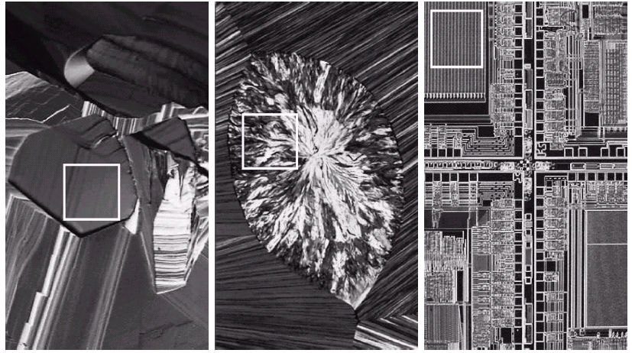
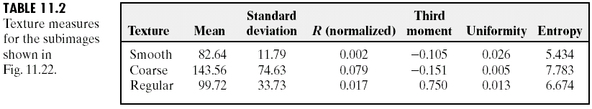
Regional Descriptors
Texture: Statistical Approaches…
A. Superconductor (smooth texture)
B. Cholesterol (coarse texture)
C. Microprocessor (regular texture)
A
B
C
A
B
C

Slide 32
import numpy as np
from skimage import io, color
from scipy import stats
# Load and convert the image to grayscale
image_path = 'coins.jpg'
image = io.imread(image_path)
gray_image = color.rgb2gray(image)
# Flatten the image to 1D array for simplicity in calculations
pixels = gray_image.flatten()
# Mean and Standard Deviation
mean = np.mean(pixels)
std_dev = np.std(pixels)
# Skewness
skewness = stats.skew(pixels)
# Smoothness
smoothness = 1 - 1/(1 + std_dev**2)
Python Code for Computing Regional Texture Descriptors:
# For Uniformity and Entropy, we need to calculate the histogram
hist, _ = np.histogram(pixels, bins=256, range=(0, 1), density=True)
uniformity = np.sum(hist**2)
entropy = -np.sum(hist*np.log2(hist + 1e-9)) # Adding a small value to avoid log(0)
print(f"Mean: {mean}")
print(f"Standard Deviation: {std_dev}")
print(f"Skewness: {skewness}")
print(f"Smoothness: {smoothness}")
print(f"Uniformity: {uniformity}")
print(f"Entropy: {entropy}")

Slide 33
Feature Detection and Feature Extraction
Feature detection selects regions of an image that have unique content, such as corners or blobs.
Use feature detection to find points of interest that you can use for further processing.
These points do not necessarily correspond to physical structures, such as the corners of a table. The key to feature detection is to find features that remain locally invariant so that you can detect them even in the presence of rotation or scale change.

Slide 34
Feature Detection and Feature Extraction
Feature extraction involves computing a descriptor, which is typically done on regions centered around the detected features.
Descriptors transform a local pixel neighborhood into a compact vector representation. This new representation permits comparison between neighborhoods regardless of changes in scale or orientation.
Descriptors, such as HOG or SURF, rely on local gradient computations.
Binary descriptors, such as BRISK, ORB or FREAK, rely on pairs of local intensity differences, which are then encoded into a binary vector.

Slide 35
Local Features
Local features refer to a pattern or distinct structure found in an image, such as a point, edge, or small image patch.
They are usually associated with an image patch that differs from its immediate surroundings by texture, color, or intensity.
What the feature actually represents does not matter, just that it is distinct from its surroundings. Examples of local features are blobs, corners, and edge pixels.

Slide 36
Local Feature Detection and Extraction
Local features and their descriptors, which are a compact vector representations of a local neighborhood, are the building blocks of many computer vision algorithms.
Their applications include image registration, object detection and classification, tracking, and motion estimation.
Using local features enables these algorithms to better handle scale changes, rotation, and occlusion.
You can mix and match the detectors and the descriptors depending on the requirements of your application.

Slide 37
Local Features: Applications
Local features let you find image correspondences regardless of occlusion, changes in viewing conditions, or the presence of clutter. In addition, the properties of local features make them suitable for image classification.
Local features are used in two fundamental ways:
To represent image contents compactly for detection or classification, without requiring image segmentation.
To localize anchor points for use in image stitching or 3-D reconstruction.

Slide 38
What Makes a Good Local Feature?
Repeatable detections
When given two images of the same scene, most features that the detector finds in both images are the same. The features are robust to changes in viewing conditions and noise.
Localizable
The feature has a unique location assigned to it. Changes in viewing conditions do not affect its location.

Slide 39
Choose a Descriptor Method
Descriptor | Binary | Function and Method in MatLab | Invariance |  | Typical Use
 |  |  | Scale | Rotation | Finding Point Correspondences | Classification
HOG | No | extractHOGFeatures(I, ...) | No | No | No | Yes
LBP | No | extractLBPFeatures(I, ...) | No | Yes | No | Yes
SURF | No | extractFeatures(I,points,'Method','SURF') | Yes | Yes | Yes | Yes
KAZE | No | extractFeatures(I,points,'Method','KAZE') | Yes | Yes | Yes | Yes
FREAK | Yes | extractFeatures(I,points,'Method','FREAK') | Yes | Yes | Yes | No
BRISK | Yes | extractFeatures(I,points,'Method','BRISK') | Yes | Yes | Yes | No
ORB | Yes | extractFeatures(I,points,'Method','ORB') | No | Yes | Yes | No
Block Simple pixel neighborhood around a keypoint | No | extractFeatures(I,points,'Method','Block') | No | No | Yes | Yes

